Slide 1



COURSE NAME : Data Science
PROJECT TITLE : Credit card default prediction
PROJECT SUBMITTED TO: Anna University \ Naan mudhalvan \IBM
YEAR : 3rd year
DEPARTMENT : BE.EEE
SEMESTER : 6th SEM
PROJECT SUBMITTED BY: J.Ashraf

Slide 2

Credit Card Default Prediction

Slide 3
Table of Contents:
Abstract
Problem statement
Introduction
Understanding the Problem Statement
Data Pre-processing
Preparing Data for Exploratory Data Analysis (EDA)
Exploratory Data Analysis
Evaluating the model
Conclusion

Slide 4
Abstract:
Credit card default prediction is a crucial task for financial institutions. Accurately predicting the probability of default can help banks and credit card companies to better manage risk, reduce losses, and optimize their lending strategies.
In this paper, a machine learning-based strategy to predict credit card default is proposed. A dataset of credit card clients from Taiwan has been utilized for the same. Various machine learning algorithms, including logistic regression, SVM, and ANN, have been used to develop predictive models.

Slide 5
Problem statement
This project is aimed at predicting the case of customers' default payments in Taiwan. From the perspective of risk management, the result of predictive accuracy of the estimated probability of default will be more valuable than the binary result of classification - credible or not credible clients.
We have to evaluate which customers will default on their credit card payments. Financial threats are displaying a trend about the credit risk of commercial banks as the incredible improvement in the financial industry has arisen.
In this way, one of the biggest threats faced by commercial banks is the risk prediction of credit clients. To analyse and predict the above given database, the current project is developed. This project is an attempt to identify credit card customers who are more likely to default in the coming month.

Slide 6
Introduction
Credit-Card Default Definition – When a customer applies for and receives a credit card, it becomes a huge responsibility for the customer as well as the credit card issuing company. The credit card company evaluates the customer’s credit worthiness and gives him/her a line of credit that they feel the customer can be responsible for.
While most people will use their card to make purchases and then diligently make payments on what they charge, there are some people who, for one reason or another, do not keep up on their payments and eventually go into credit card default.
Credit card default is the term used to describe what happens when a credit card user makes purchases by charging them to their credit card and then they do not pay their bill. It can occur when one payment is more than 30 days past due, which may raise your interest rate.

Slide 7
Most of the time, the term default is used informally when the credit card payment is more than 60 days past due. A default has a negative impact on the credit report and most likely leads to higher interest rates on future borrowing. In recent years, the credit card issuers are facing the cash and credit card debt crisis as they have been over-issuing cash and credit cards to unqualified applicants, in order to increase their market share.
At the same time, most cardholders, irrespective of their repayment ability, overused credit cards for consumption and accumulated heavy credit and cash–card debts. The crisis is an omen for the blow to consumer finance confidence and it is a big challenge for both banks and cardholders.

Slide 8
Understanding the Problem Statement:
This project is an attempt to identify credit card customers who are more likely to default in the coming month. A lot of credit card issuing companies are working on predictive models which would help them predict the payment status of the customer ahead of time using the customer’s credit score, credit history, payment history and other factors.
This project is aimed at using customer’s personal and financial information like credit line, age, repayment and delinquency history for the past 6 months to predict the probability of the particular customer to become default next month.

Slide 9
Many statistical and data mining techniques will be used to build a binary predictive model. If the credit card issuing companies can effectively predict the imminent default of customers beforehand, it will help them to pursue targeted customers and take calculated efforts to avoid the default, to overcome future losses efficiently.
The data, in any sense, does not directly reveal the identity of any individual or provide information that could be decrypted to connect to an individual. In this project, the plan is to predict the probability of credit-card holders to go default in the next month by using payment data from October 2015 to March 2016.

Slide 10
Among the total 30,000 observations,To determine the binary variable – default payment in April 2016 (Yes = 1, No = 0), as the response variable. Some of the key attributes consisting those variables which are used for this project are listed below:
Attributes and their Description This research employed a binary variable, default payment (Yes = 1, No = 0), as the response variable. This study reviewed the literature and used the following 23 variables as explanatory variables:
● X1: Amount of the given credit (NT dollar): it includes both the individual consumer credit and his/her family (supplementary) credit.
● X2: Gender (1 = male; 2 = female).

Slide 11
X3: Education (1 = graduate school; 2 = university; 3 = high school; 4 = others).
X4: Marital status (1 = married; 2 = single; 3 = others).
X5: Age (year).
X6 - X11: History of past payment. We tracked the past monthly payment records (from April to September, 2005) as follows: X6 = the repayment status in September, 2005; X7 = the repayment status in August, 2005; . . .; X11 = the repayment status in April, 2005. The measurement scale for the repayment status is: -1 = pay duly; 1 = payment delay for one month; 2 = payment delay for two months; . . .; 8 = payment delay for eight months; 9 = payment delay for nine months and above.

Slide 12
X12-X17: Amount of bill statement (NT dollar). X12 = amount of bill statement in September, 2005; X13 = amount of bill statement in August, 2005; . . .; X17 = amount of bill statement in April, 2005.
X18-X23: Amount of previous payment (NT dollar). X18 = amount paid in September, 2005; X19 = amount paid in August, 2005; . . .;X23 = amount paid in April,2005.

Slide 13
Data Pre-processing
Before jumping to the exploration stage, we need to perform basic data pre-processing steps like null value imputation and removal of unwanted data.
Handling Null Values:
There are a few null values in the dataset. The major part of the dataset is null values which triggers many stumbling blockages in processing the necessary columns, therefore it is required to identify the columns containing lump sum null values and get dropped. So, let’s drop these null values columns which contain more than 80 percent of null values.

Slide 14
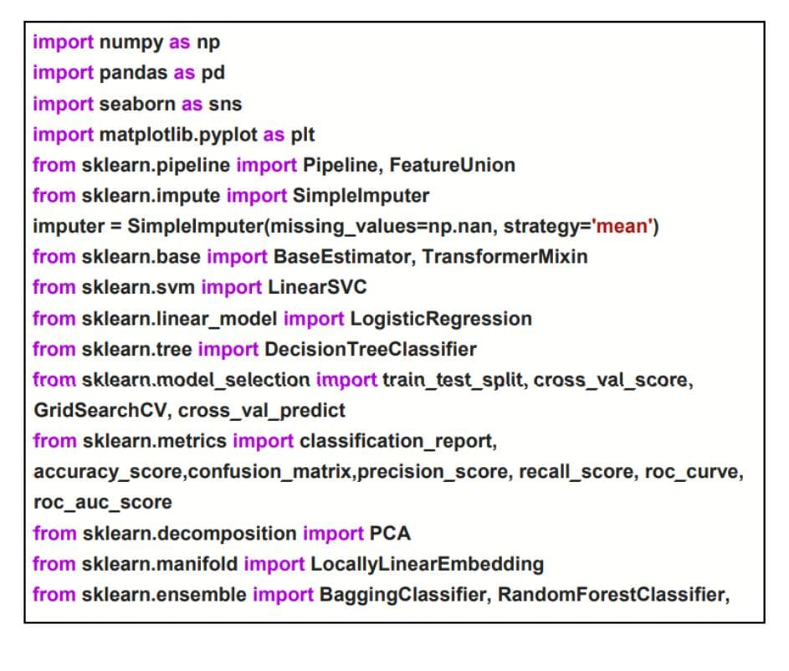
Libraries Used : The dataset contains 30000 rows and 25 columns. But we only need information about important columns.and dropping other unwanted columns.
Libraries Used :Pandas ,Numpy , Matplolib, Seaborn,Sklearn

Slide 15
Preparing Data for Exploratory Data Analysis (EDA) :
Data loading:
We have loaded the data into our drive and then finally loaded it to google colab notebook using pandas library.
Renaming the columns:
This method is useful because it lets you modify a column heading without having to create a new column.
Removing unwanted columns from dataset
Renaming the columns
One way of renaming the columns in a Pandas data frame is by using the rename() function. This method is quite useful when we need to rename some selected columns because we need to specify information only for the columns which are to be renamed.

Slide 16
Exploratory Data Analysis:
Shape :
The shape attribute tells us a number of observations and variables we have in the data set. It is used to check the dimension of data. The given data set has more than 30000 observations and 23 variables in the data set.
Describe :
If computes a summary of statistics pertaining to the DataFrame columns. This function gives the mean, std and IQR values. And, function excludes the character columns and gives a summary about numeric columns.

Slide 17
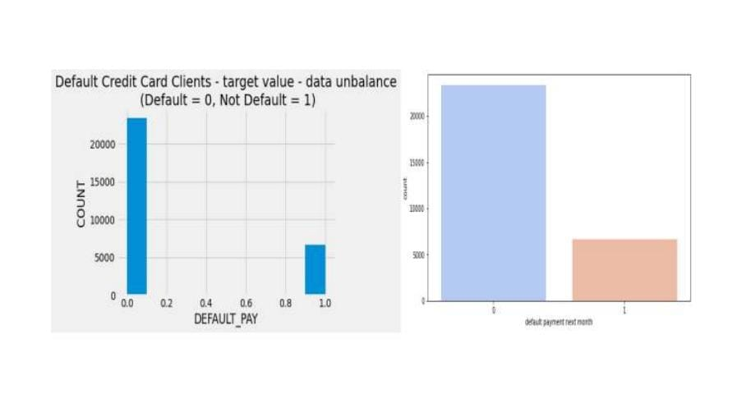
Analysis of different variables : Analysing the default pay : From the above graph on x-axis 0 indicates as not a default payment and 1 indicates the default payment.From this we can say that for more customers there are no default payments for next month.

Slide 18
Analysing the customers based on their Education :
Education (1 = graduate school; 2 = university; 3 = high school; 4 = others) It might be useful to see whether the education level of the customer is in any way related to his/her probability of default.
The distribution of defaults based on education level will be an interesting chart to look at. More number of credit holders are university students followed by Graduates and then High school students.

Slide 19
Analysing the customers based on their Education:
Education (1 = graduate school; 2 = university; 3 = high school; 4 = others) It might be useful to see whether the education level of the customer is in any way related to his/her probability of default.
The distribution of defaults based on education level will be an interesting chart to look at. More number of credit holders are university students followed by Graduates and then High school students.
Gender (1 = male; 2 = female) It might be useful to see whether the gender of the customer is in any way related to his/her probability of default.

Slide 20
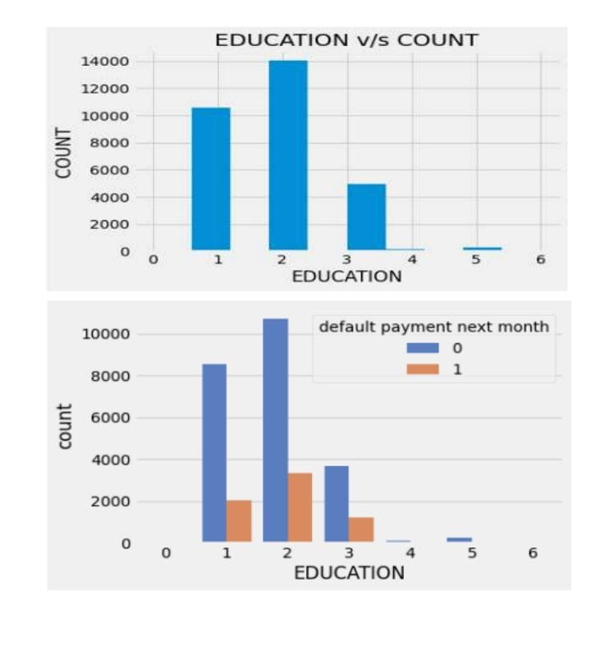
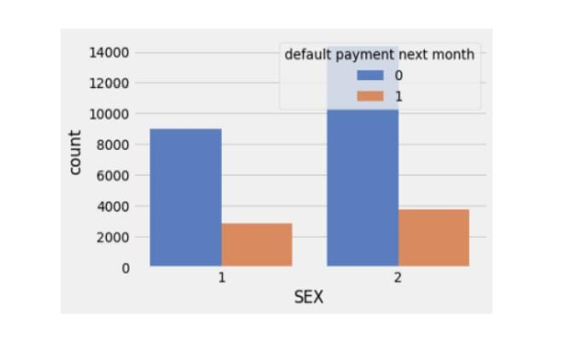

Slide 21
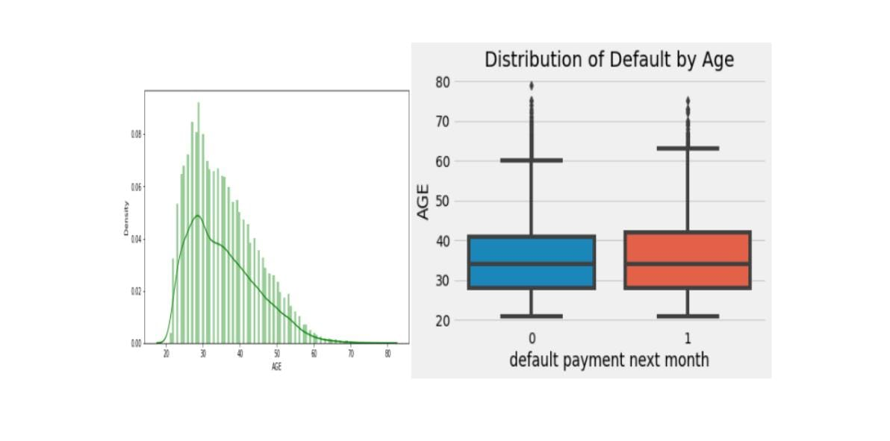
Analysing the age of the customers:
Age (year) It might be useful to see whether the gender of the customer is in any way related to his/her probability of default. From the above graphs we can say that most of the customers are from the age group of 25-30 years.

Slide 22
Evaluating the model :
After the model is built, if we see that the difference in the values of the predicted and actual data is not much, it is considered to be a good model and can be used to make future predictions.
1.Confusion Matrix:
It is nothing but a tabular representation of Actual vs Predicted values. This helps us to find the accuracy of the model and avoid overfitting. This is how it looks like: Calculate the accuracy of your model with

Slide 23
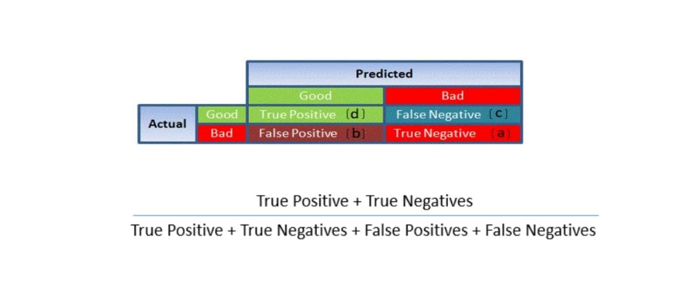
Confusion Matrix:

Slide 24
2. ROC Curve
Receiver Operating Characteristic(ROC) summarizes the model’s performance by evaluating the trade-offs between true positive rate (sensitivity) and false positive rate(1- specificity). For plotting ROC, it is advisable to assume p > 0.5 since we are more concerned about success rate.
ROC summarizes the predictive power for all possible values of p > 0.5. The area under curve (AUC), referred to as index of accuracy(A) or concordance index, is a perfect performance metric for ROC curve. Higher the area under the curve, better the prediction power of the model. Below is a sample ROC curve. The ROC of a perfect predictive model has TP equals 1 and FP equals 0. This curve will touch the top left corner of the graph

Slide 25
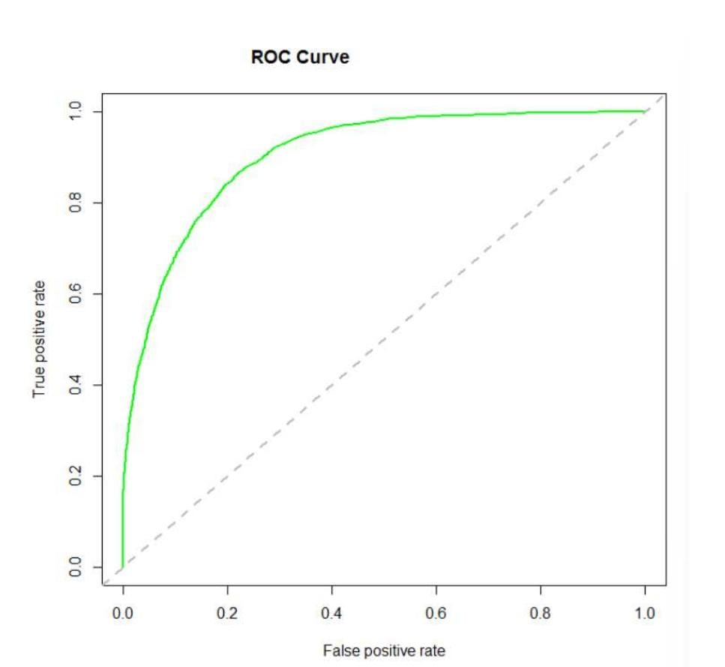

Slide 26
Conclusion :
The conclusion of a credit card default prediction model typically involves summarizing the key findings, evaluating the model's performance metrics (such as accuracy, precision, recall, and F1-score), and determining the most important features contributing to default prediction. It's also important to discuss any limitations of the model and potential areas for improvement.

